Slide 1
Math 769: Statistical Learning

Slide 2
LASSO
Shahrzad Jamshidi, PhD

Slide 3
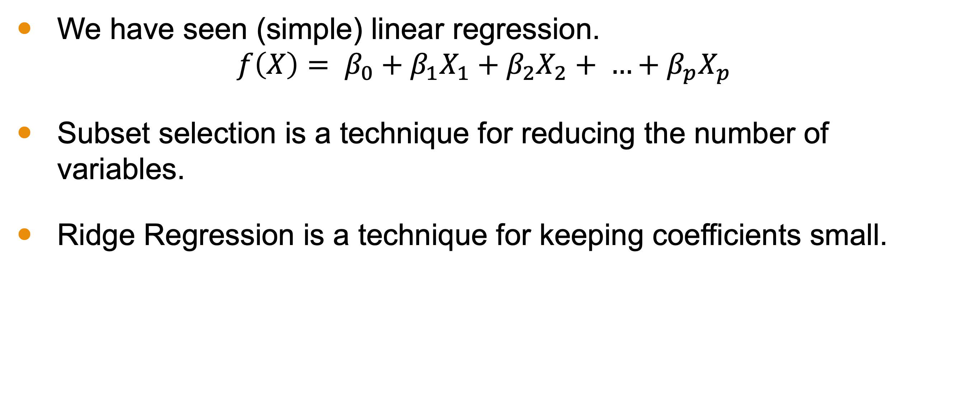
Last Lesson
We have seen (simple) linear regression.
$$f\left(X\right)= β_{0}+β_{1}X_{1}+β_{2}X_{2}+ …+β_{p}X_{p}$$
Subset selection is a technique for reducing the number of variables.
Ridge Regression is a technique for keeping coefficients small.

Slide 4
Objectives
Define LASSO regression.
Explain why LASSO is different from Ridge.
Describe the strengths and weaknesses of LASSO.

Slide 5
Issues with Linear Regression
Overfitting
Model becomes too complex; captures noise.
Many features
Not all might be relevant.
Large Coefficients
Could lead to unstable predictions.

Slide 6
Regularization
Idea: Add a penalty to the linear regression coefficients!
Helps in reducing model complexity.
Ridge regression is one such regularization technique; LASSO is another!

Slide 7
LASSO - Intuition
Instead of just minimizing the sum of squared residuals, also minimize the magnitude of coefficients.
Difference from ridge: coefficients more easily go to zero.
We trade off between fitting our data well and keeping coefficients small.

Slide 8
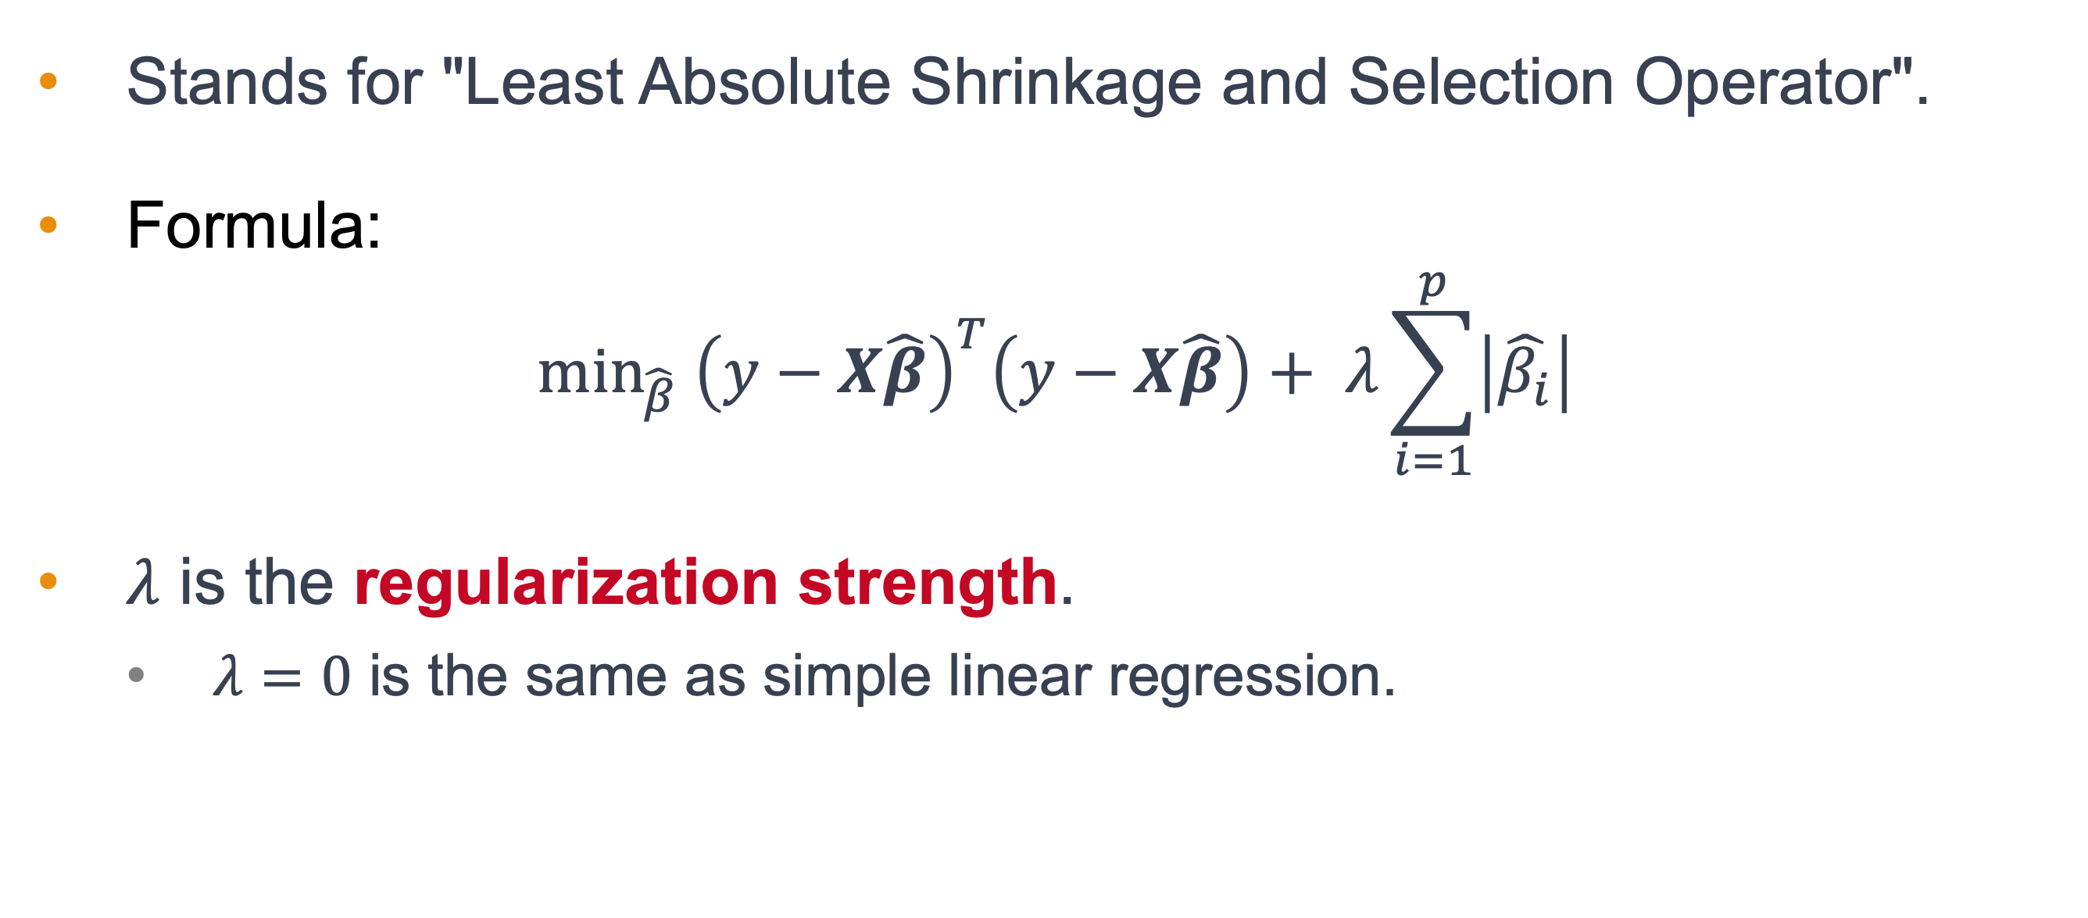
Basics of LASSO Regression
Stands for "Least Absolute Shrinkage and Selection Operator".
Formula:
$$\min_{\hat{β}} {\left(y−X\hat{β}\right)}^{T}\left(y−X\hat{β}\right)+ λ\sum_{i=1}^{p}{\left|\hat{β_{i}}\right|}$$
$λ$ is the regularization strength.
$λ=0$ is the same as simple linear regression.

Slide 9
What Distinguishes LASSO?
Regularization penalizes the absolute value of coefficients; not the squares.
Side Effect
Can reduce some coefficients to exactly zero and eliminate them altogether!
Naturally performs variable/feature selection.

Slide 10
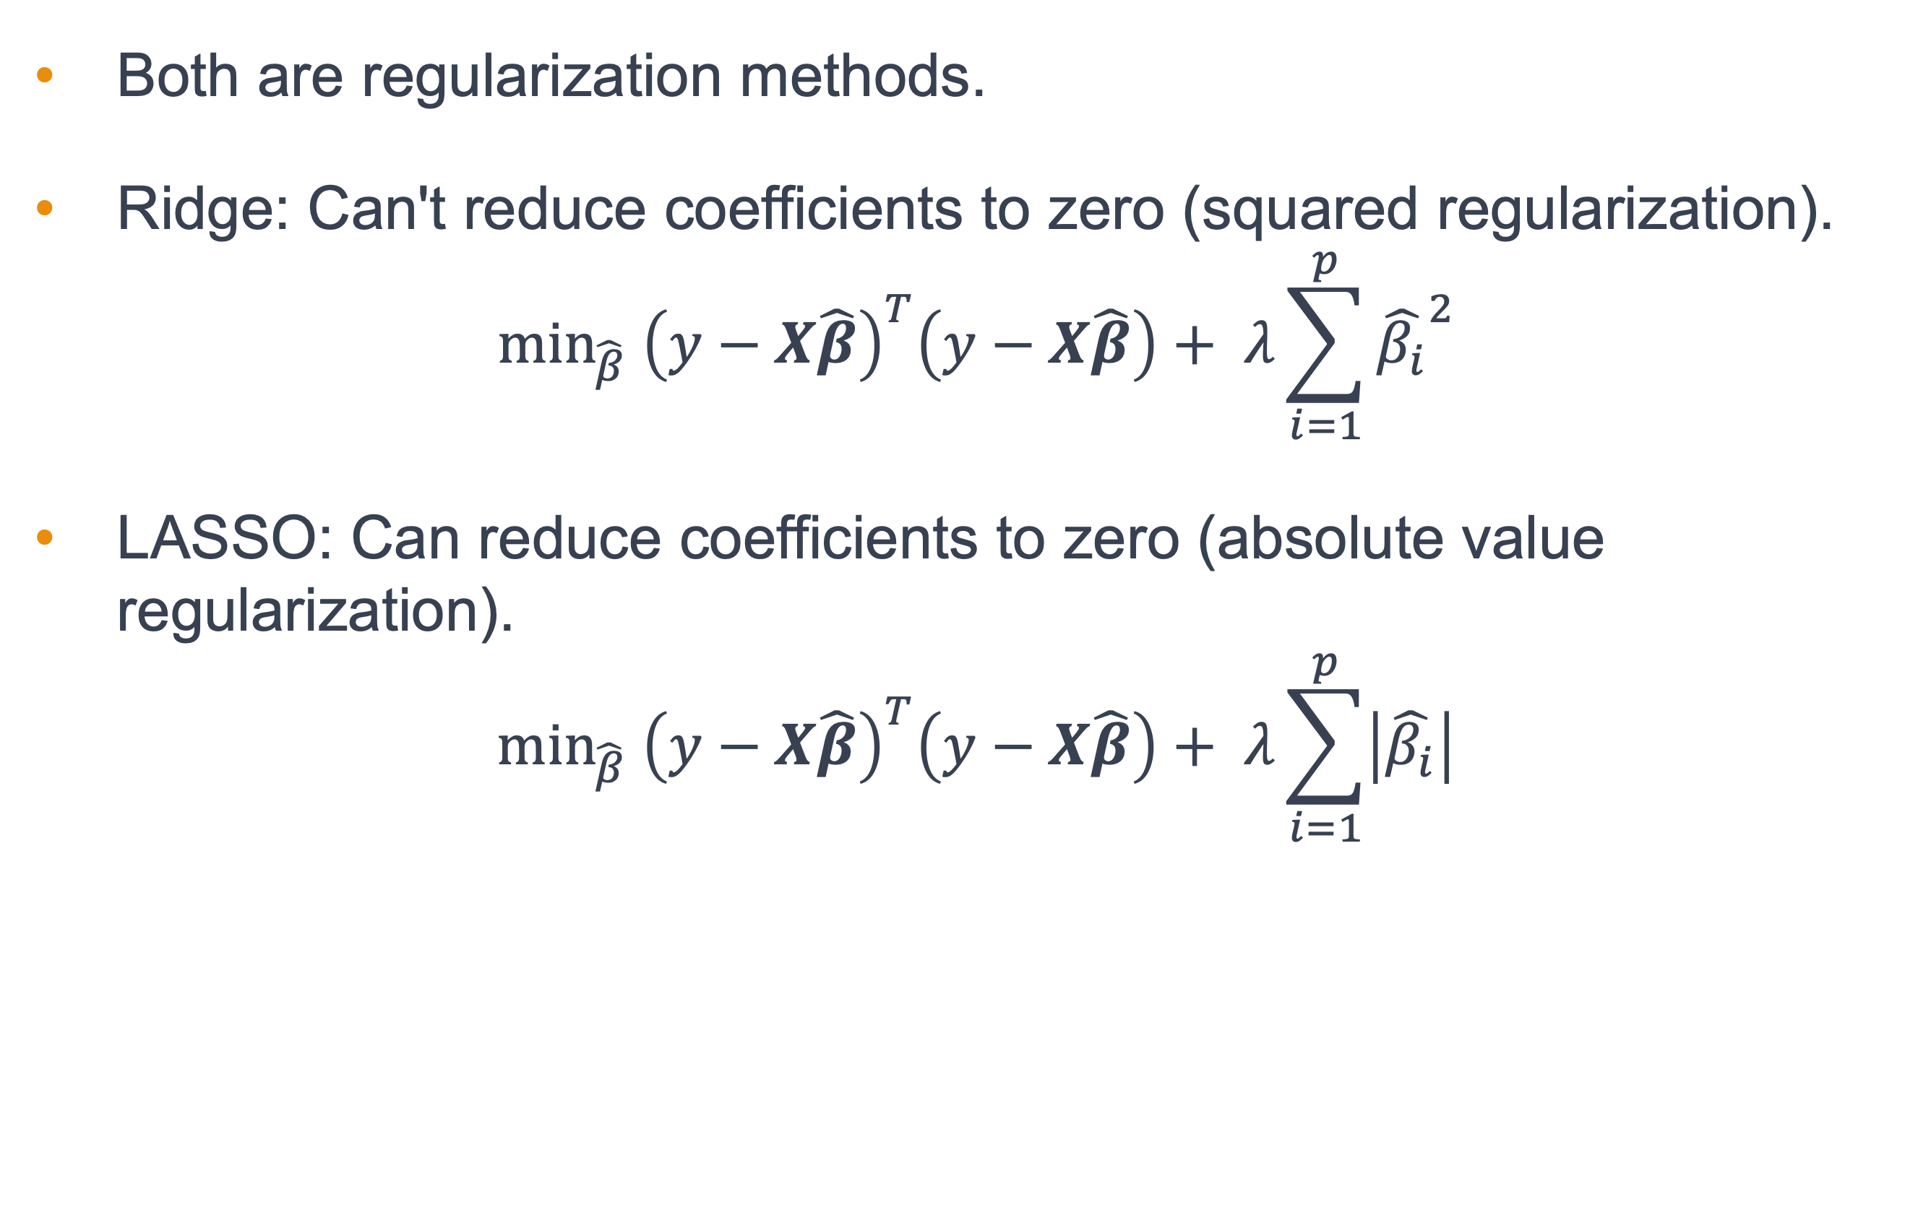
LASSO versus Ridge
Both are regularization methods.
Ridge: Can't reduce coefficients to zero (squared regularization).
$$\min_{\hat{β}} {\left(y−X\hat{β}\right)}^{T}\left(y−X\hat{β}\right)+ λ\sum_{i=1}^{p}{{\hat{β_{i}}}^{2}}$$
LASSO: Can reduce coefficients to zero (absolute value regularization).
$$\min_{\hat{β}} {\left(y−X\hat{β}\right)}^{T}\left(y−X\hat{β}\right)+ λ\sum_{i=1}^{p}{\left|\hat{β_{i}}\right|}$$

Slide 11
Why does this happen?
Notes:
This is where the linear algebra comes in

Slide 12
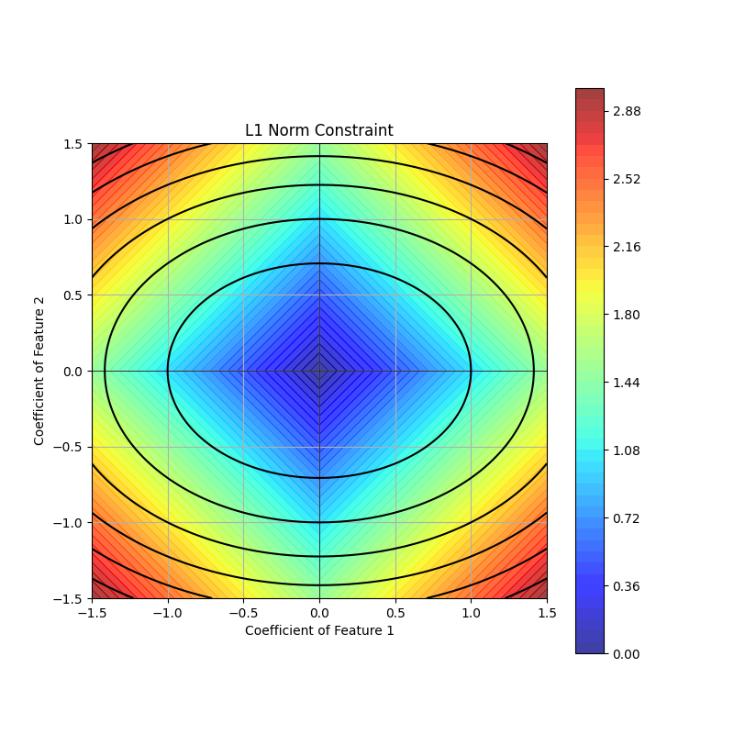
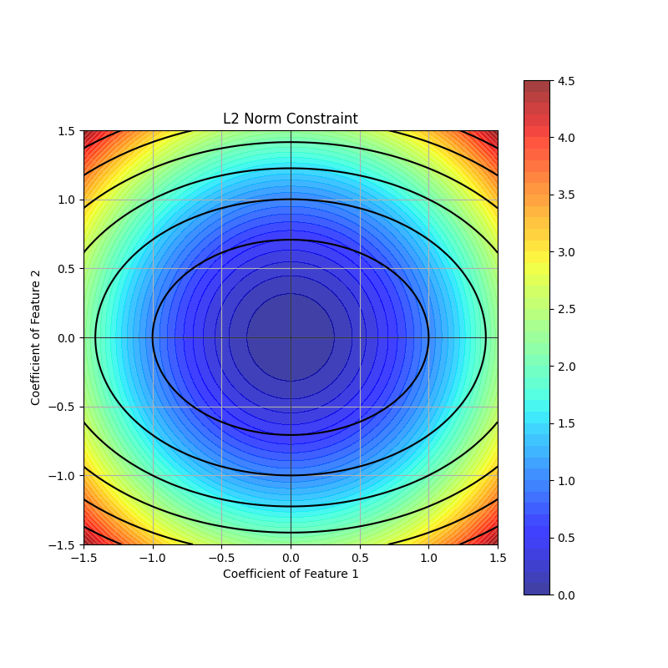

Geometry of $\left|∗\right|$ versus $∗^{2}$
Notes:
To visually demonstrate why the L1 norm leads to sparsity (coefficients tending to zero) more easily than the L2 norm, we can plot the contours of the L1 and L2 norms alongside the contours of a hypothetical least squares error surface. This provides a geometric interpretation.
In these plots, the colors represent the magnitude of the respective norms (darker colors are closer to zero). The black ellipses represent the contours of a quadratic loss function.
In the L1 image, you can see that the "corners" of the diamond (representing the L1 constraint) are more likely to intersect the RSS contour first, which is why some coefficients tend to go to zero.
In the L2 image, the circle doesn't have the same corners, so coefficients shrink, but don't necessarily go to zero as clearly.
These plots provide a geometric understanding of why L1 regularization encourages sparser solutions compared to L2 regularization.

Slide 13
Benefits of LASSO
Feature Selection
Ignores irrelevant variables by setting their coefficients to zero.
Predictive Accuracy
Can reduce overfitting by simplifying the model.
Interpretability
With fewer features, the model can be easier to understand.

Slide 14
Limitations of LASSO
Not always the best choice for highly correlated features.
In cases with more features than samples, LASSO selects at most n features (where n = number of samples).

Slide 15
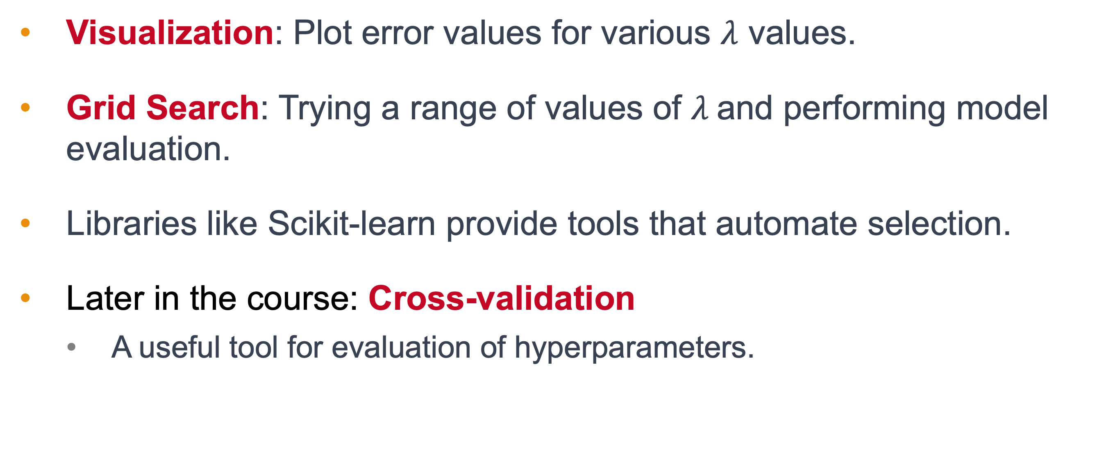

How to Choose $λ$
Visualization: Plot error values for various $λ$ values.
Grid Search: Trying a range of values of $λ$and performing model evaluation.
Libraries like Scikit-learn provide tools that automate selection.
Later in the course: Cross-validation
A useful tool for evaluation of hyperparameters.

Slide 16
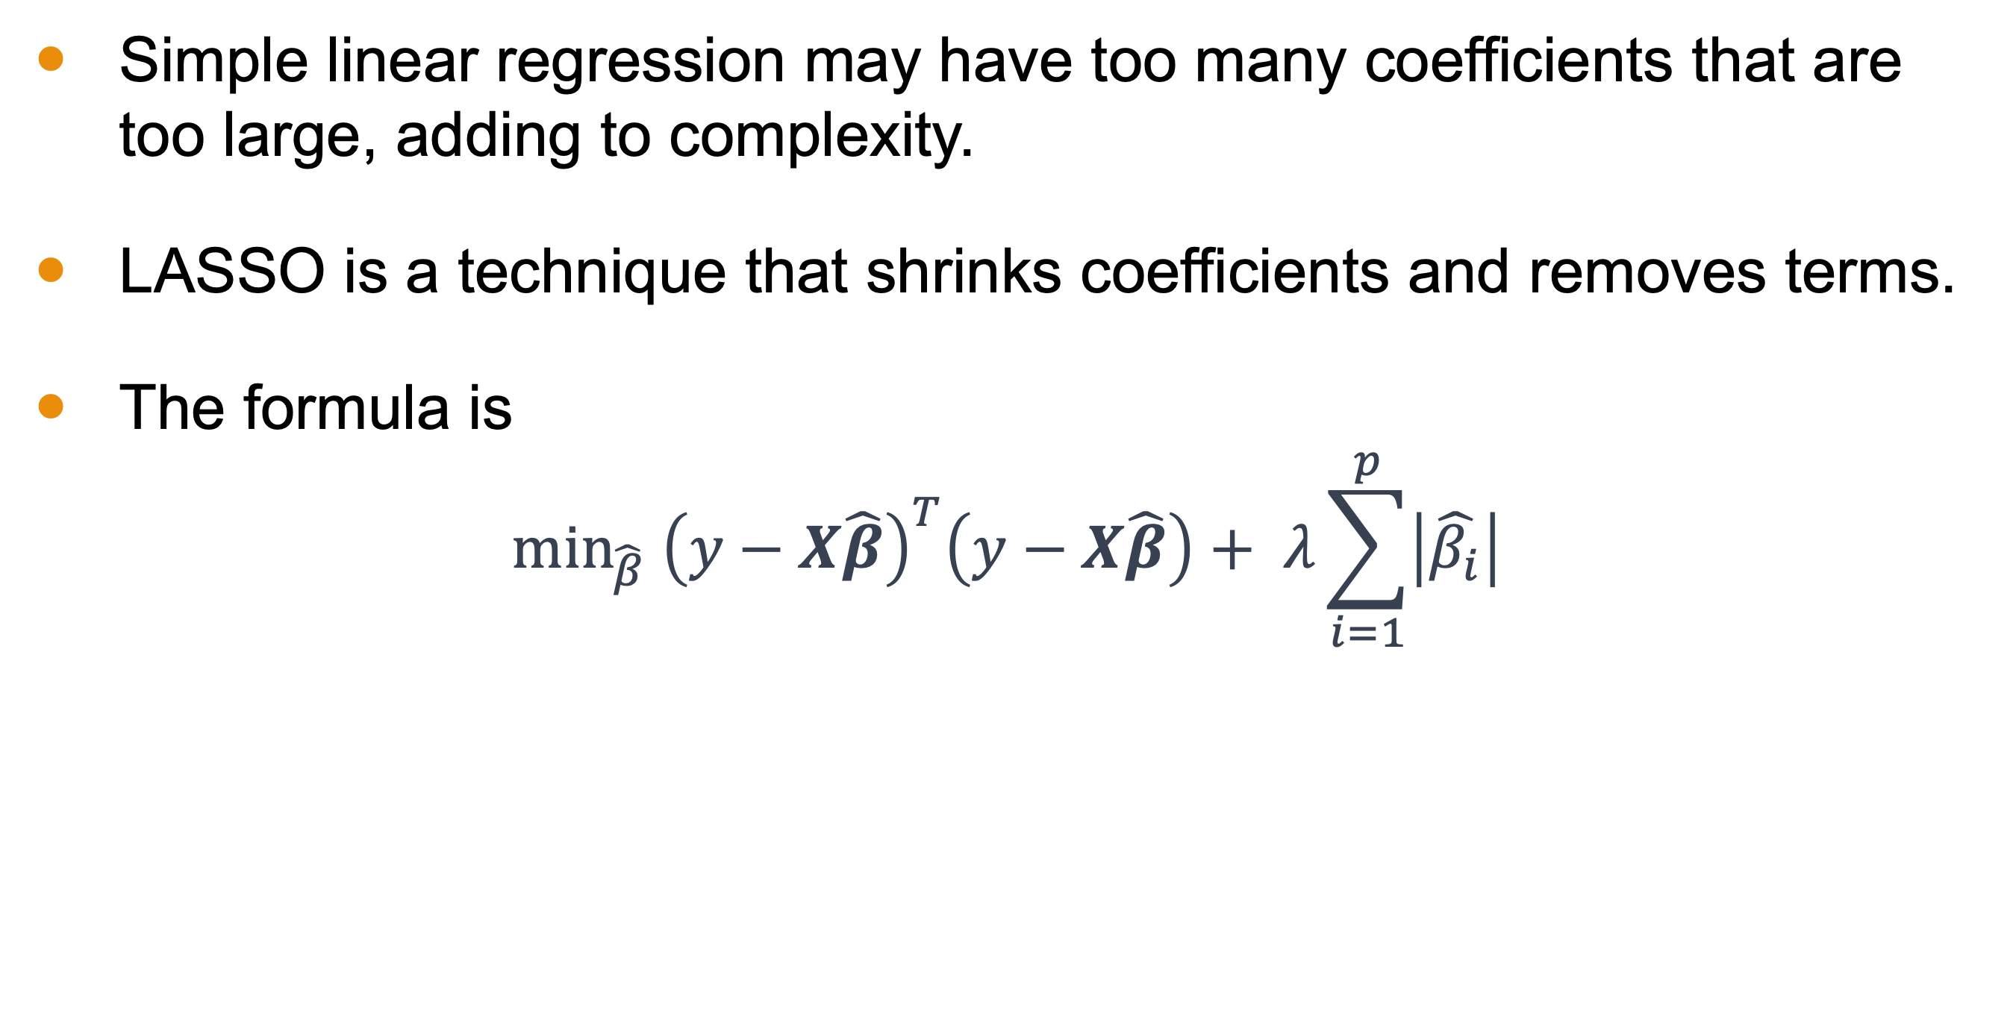
Conclusion
Simple linear regression may have too many coefficients that are too large, adding to complexity.
LASSO is a technique that shrinks coefficients and removes terms.
The formula is
$$\min_{\hat{β}} {\left(y−X\hat{β}\right)}^{T}\left(y−X\hat{β}\right)+ λ\sum_{i=1}^{p}{\left|\hat{β_{i}}\right|}$$

Slide 17

Conclusion
The technique is not ideal for small samples or when variables are highly correlated.
Techniques for picking $λ$ are the same as they were for ridge regression.

